Slide 1

Connecting To Your Clients, Connecting to Your Community
Psychological Flexibility and Social Work Values
Matthew S. Boone, LCSW

Slide 2
Social work has a distinctive focus on serving the needs of people who are vulnerable, oppressed, and living in poverty

Slide 3
Preamble to NASW Code of Ethics
Social Work Values
Commitment to enhancing human well-being and helping meet the basic human needs of all people
Client empowerment and client strengths
Service to people who are vulnerable and oppressed
Focus on individual well-being in a social context
Promotion of social justice and social change
Sensitivity to cultural and ethnic diversity

Slide 4
Helping people adapt to their environments
Helping environments adapt to people

Slide 5
This problem is too big to change

Slide 6
Things have always been this way

Slide 7
What difference can one person make?

Slide 8
I just don’t have the time

Slide 9
Someone else will do it

Slide 10
It’s too much work to make a difference

Slide 11
Things will change whether or not I do anything

Slide 12
I have to figure out exactly what I think before I act

Slide 13
If I begin to care, I will get way too angry

Slide 14
Who am I to think I have anything to say about this issue?

Slide 15
I have enough to do for myself without having to fix things for others

Slide 16
I’m much better at serving individuals – there’s just so much more you can do

Slide 17
It just seems so hopeless sometimes

Slide 18

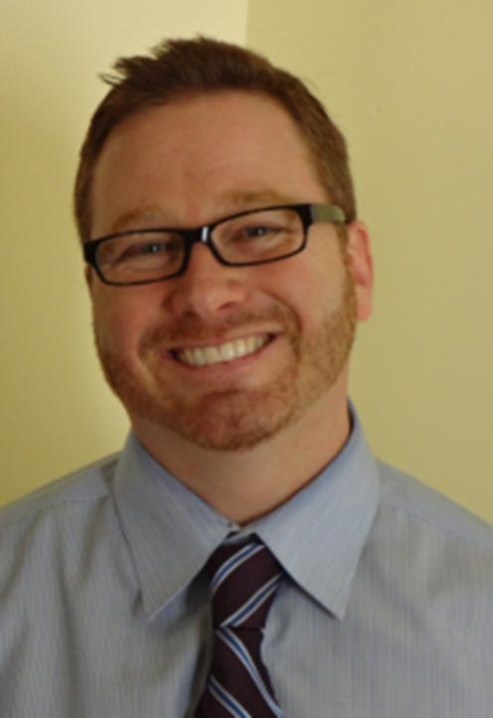

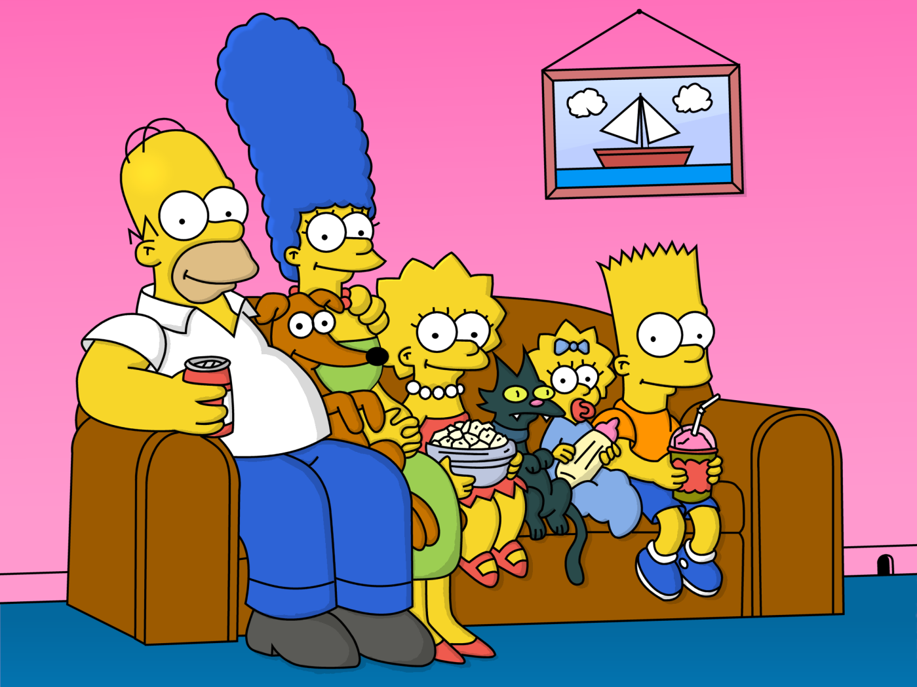
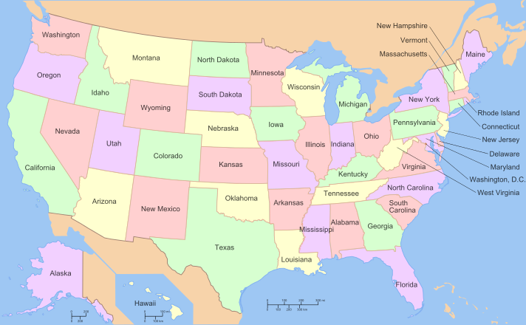
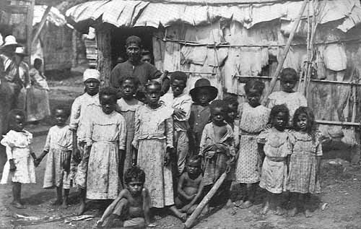



language
thoughts
feelings

Slide 19
Addressing context to facilitate change
A traditional social work intervention might include changing context by helping a client get access to needed resources or by effecting larger scale systems change (e.g., policies, political action)
ACT changes the context of thoughts and feelings rather than trying to change the thoughts and feelings themselves
e.g., undermining the context of literality supported by the verbal community (defusion context)
e.g., treating private experiences as welcome guests (acceptance context)

Slide 20
Describe a problem
Think of a problem at the group, organizational, community, or societal level which is important to you
One you would like to do something about
But one about which you have thus far not done as much as you would like
Describe it to your partner for the next few minutes
Listeners: as your best listening selves, elicit values related to this problem

Slide 21
Your struggling self

Slide 22
Your best self

Slide 23
Eyes Closed

Slide 24
Flexible Selfing

Slide 25
Commitment

